Slide 1
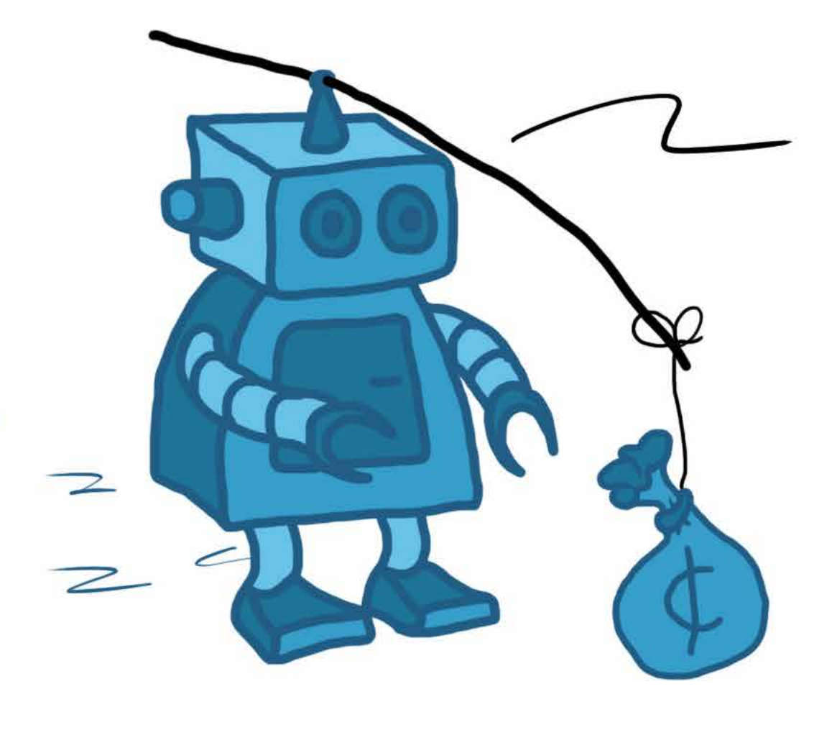
Reinforcement Learning with MATLAB and Simulink
Jordan Olson
Application Engineer, AI & Controls
jolson@mathworks.com

Slide 2
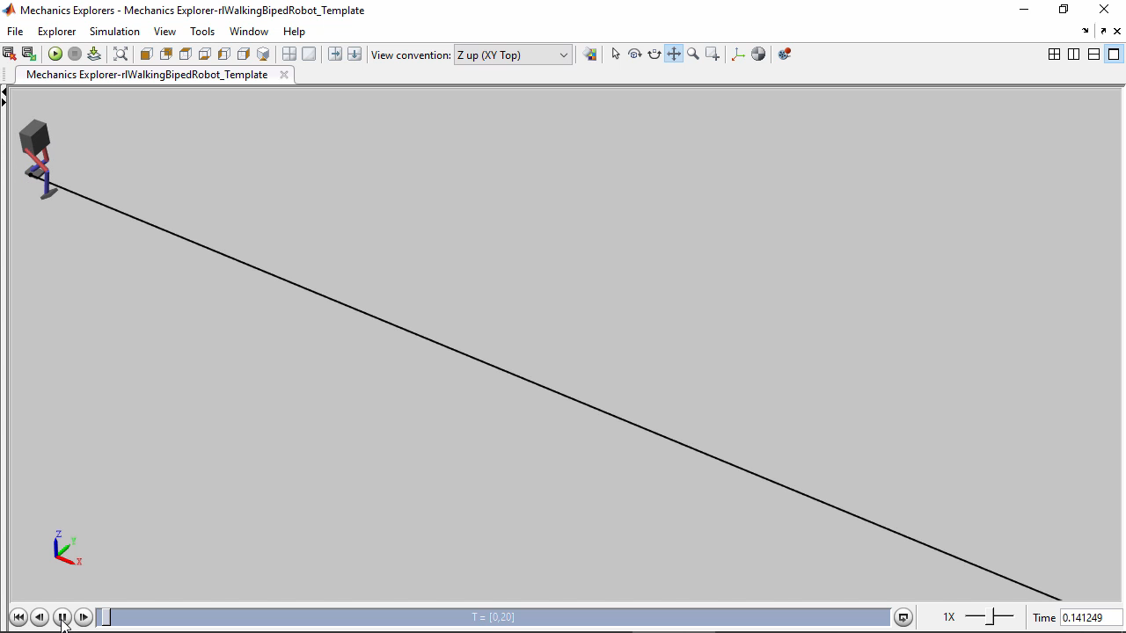
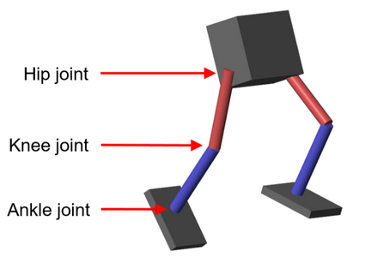
Why should you care about reinforcement learning?

Slide 3
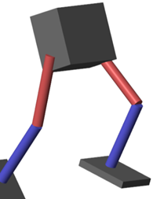
One approach could be…
State estimation
Joint trajectory generation
(e.g. MPC)
Low-level control
(e.g. PID)
Measurements
Motor torques

Slide 4
Any alternatives?
Measurements
Black Box
Controller
Motor torques

Slide 5
Key Takeaways
What is reinforcement learning and why is it useful?
When should I use reinforcement learning?
How do I set up and solve a reinforcement learning problem?

Slide 6
Agenda
Introduction to Reinforcement Learning
Deep Dive: Reinforcement Learning Workflow with Hands-On Examples
Defining environments and rewards
Creating policies and agents
Training, testing, and deploying agents
Complex problems: Teach a robot to walk!
Wrap-Up and Additional Resources

Slide 7
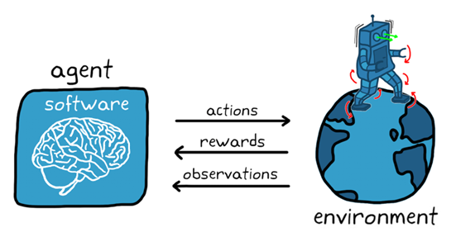
What is reinforcement learning?
Type of machine learning that trains an agent through trial & error interactions with an environment

Slide 8
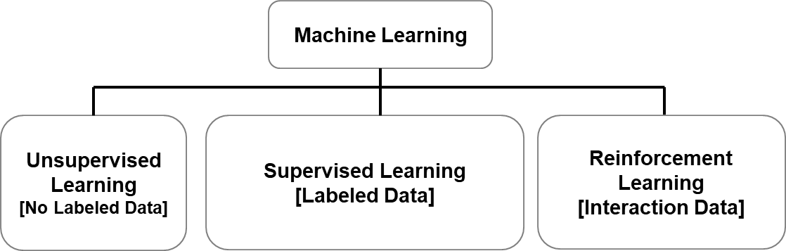



Reinforcement learning, machine learning, and deep learning

Slide 9
Reinforcement learning, machine learning, and deep learning

Slide 10
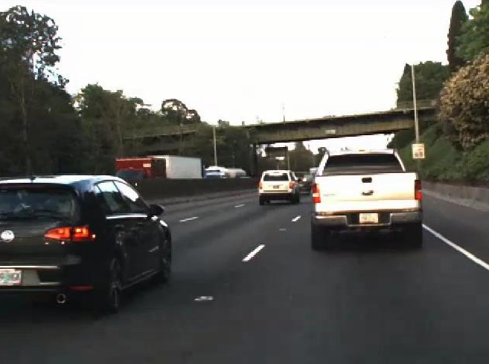
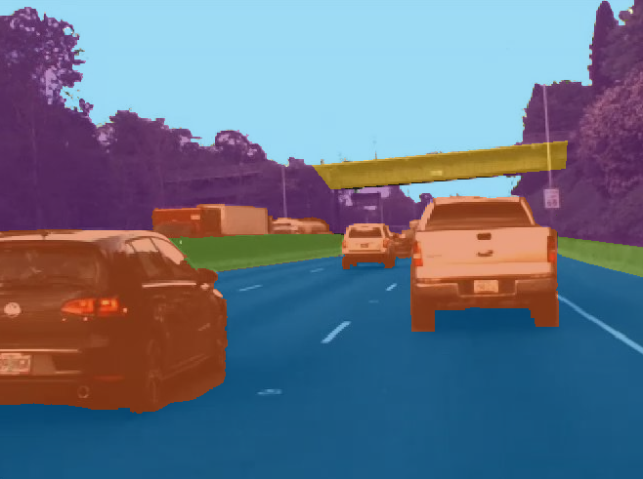
Reinforcement learning, machine learning, and deep learning

Slide 11
Reinforcement learning, machine learning, and deep learning

Slide 12
Reinforcement learning, machine learning, and deep learning
Deep Learning
What about deep learning?
Complex reinforcement learning problems typically need deep neural networks
[Deep Reinforcement Learning]

Slide 13
What can reinforcement learning be used for?
Reinforcement learning might be a good fit for your application if…
A simulation model of the system is available, and
Training/tuning time is not critical for the application, and
The environment is uncertain and/or nonlinear

Slide 14
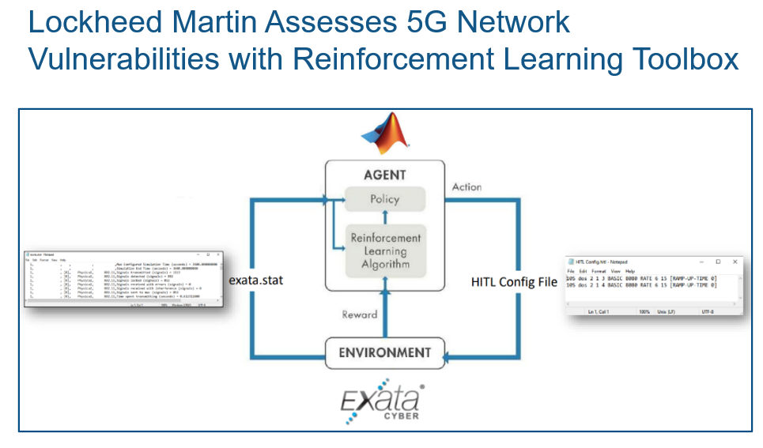
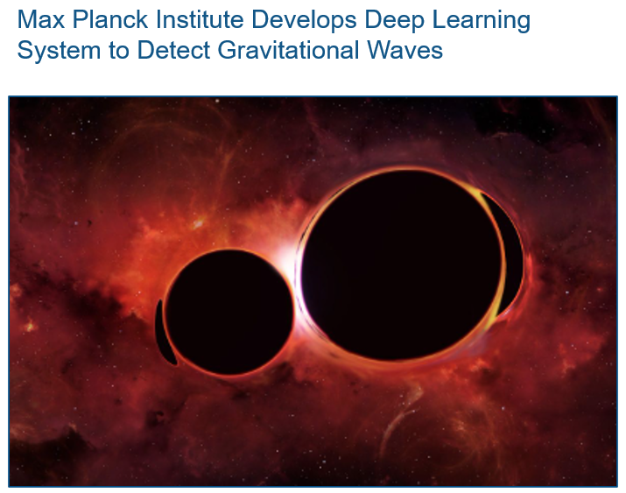
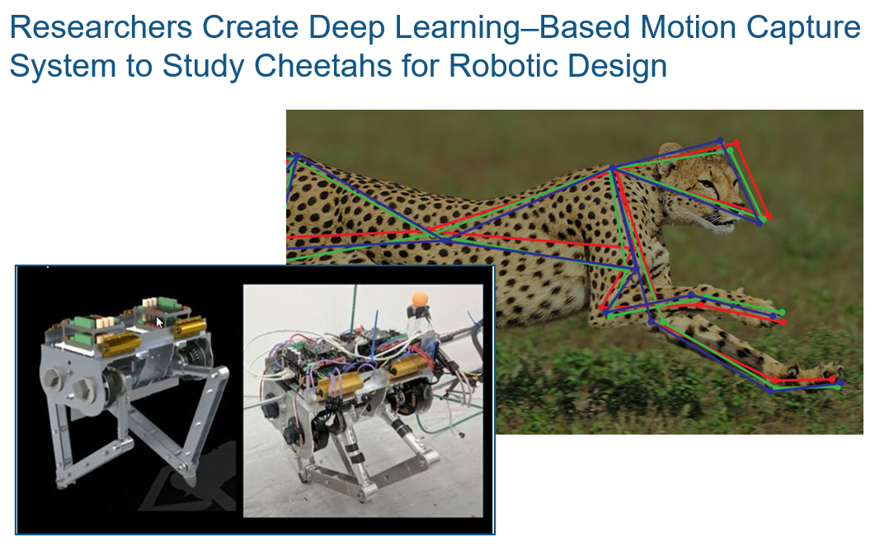
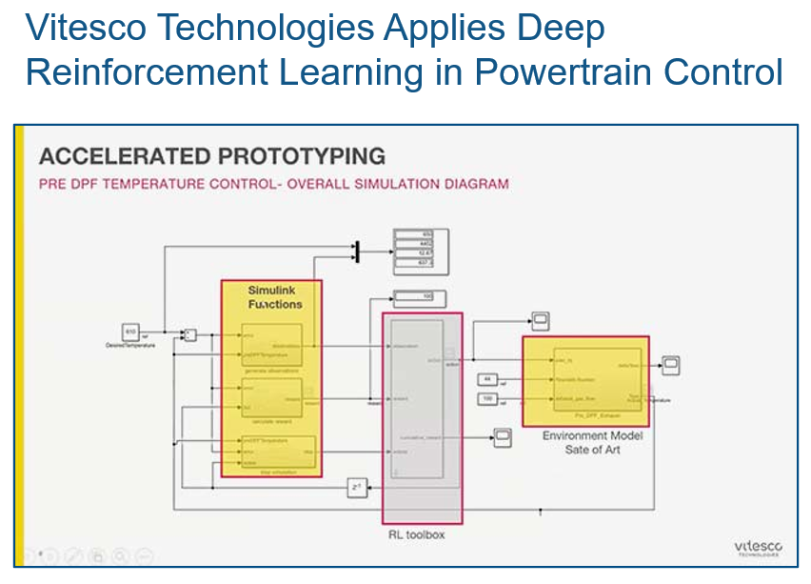
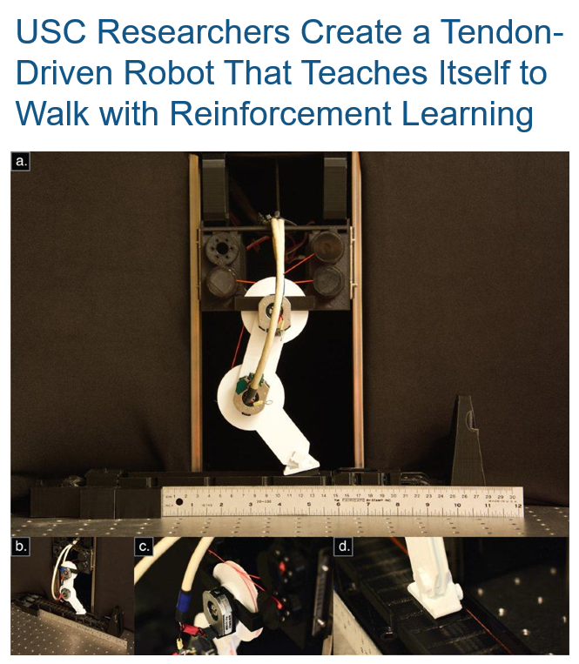
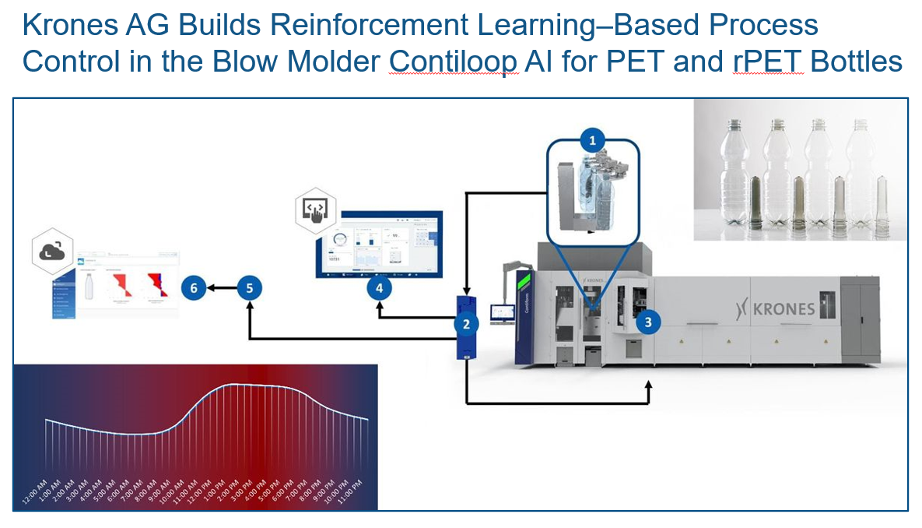
What can reinforcement learning be used for?
What could you use reinforcement learning for?

Slide 15

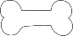

How does reinforcement learning training work?
Reinforcement learning works through trial and error.
Analogies with pet training
Let’s try this…
AGENT
OBSERVATIONS
Policy
ACTIONS
Policy update
Yay!
Here is your treat!
Reinforcement Learning Algorithm
Fetch!
REWARD
ENVIRONMENT

Slide 16
How does reinforcement learning training work?
After training, only trained policy is needed
POLICY
OBSERVATIONS
ACTIONS
ENVIRONMENT

Slide 17



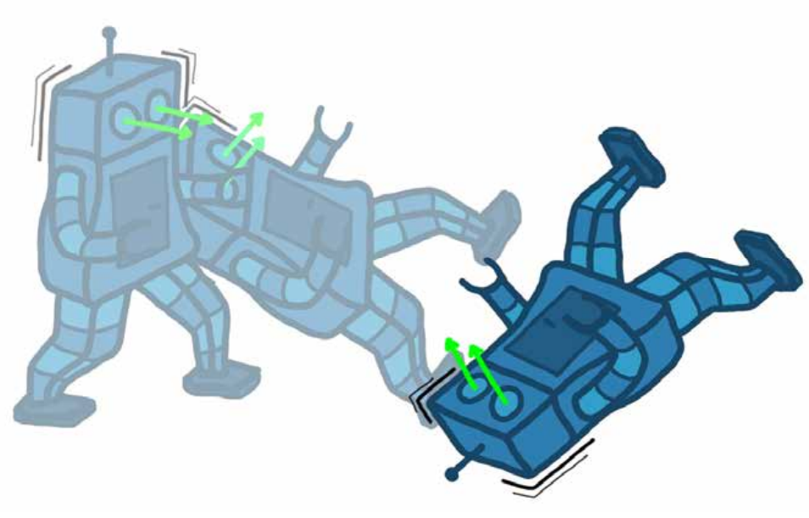

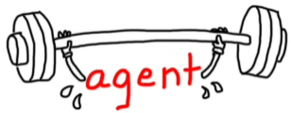
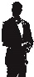
Reinforcement learning workflow
Simulation models or real hardware
Virtual models are safer and cheaper
Select training algorithm
Policy architecture
Tune hyperparameters
Simulation, SIL, PIL, HIL…
Environment
Reward
Agent
Training
Testing
Deployment
Numerical value that evaluates goodness policy
Reward shaping can be challenging
Trained policy is a standalone function
Large number of simulations needed
Parallel & GPU computing can speed up training

Slide 18
Reinforcement learning workflow
Environment
Reward
Agent
Training
Testing
Deployment
Redesign

Slide 19
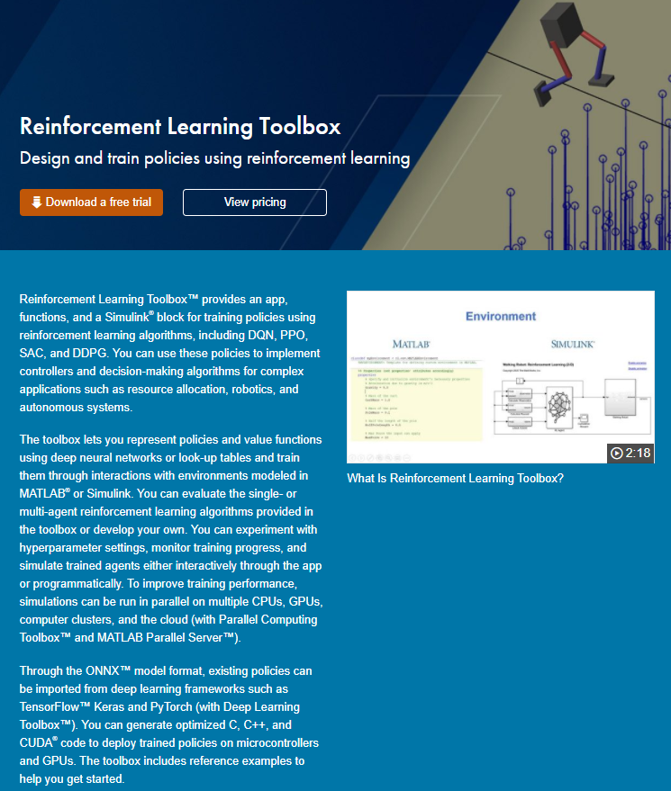
Reinforcement Learning Toolbox
Reference toolbox examples to quickly get started
Choose from many built-in algorithms (or create your own!)
Model environments in MATLAB and Simulink
Create deep neural networks using Deep Network Designer
Accelerate training with Parallel Computing Toolbox and MATLAB Parallel Server
Design agents interactively with the Reinforcement Learning Designer app
Validate policies in simulation and hardware using verification and validation tools
Deploy trained policies to embedded and production systems

Slide 20
Reinforcement Learning Toolbox
Reference toolbox examples to quickly get started
Choose from many built-in algorithms (or create your own!)
Model environments in MATLAB and Simulink
Create deep neural networks using Deep Network Designer
Design agents interactively with the Reinforcement Learning Designer app
Deploy trained policies to embedded hardware and production systems

Slide 21
Agenda
Introduction to Reinforcement Learning
Deep Dive: Reinforcement Learning Workflow with Hands-On Examples
Defining environments and rewards
Creating policies and agents
Training, testing, and deploying agents
Complex problems: Teach a robot to walk!
Wrap-Up and Additional Resources

Slide 22

Reinforcement Learning Workflow
Environment
Reward
Agent
Training
Testing
Deployment

Slide 23
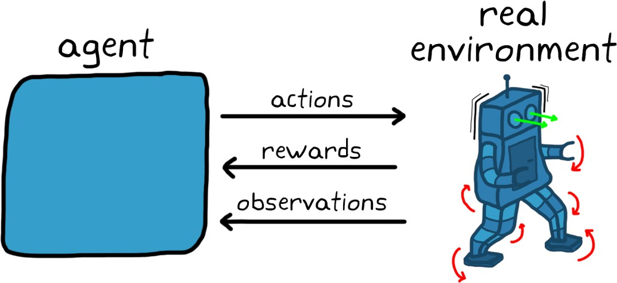
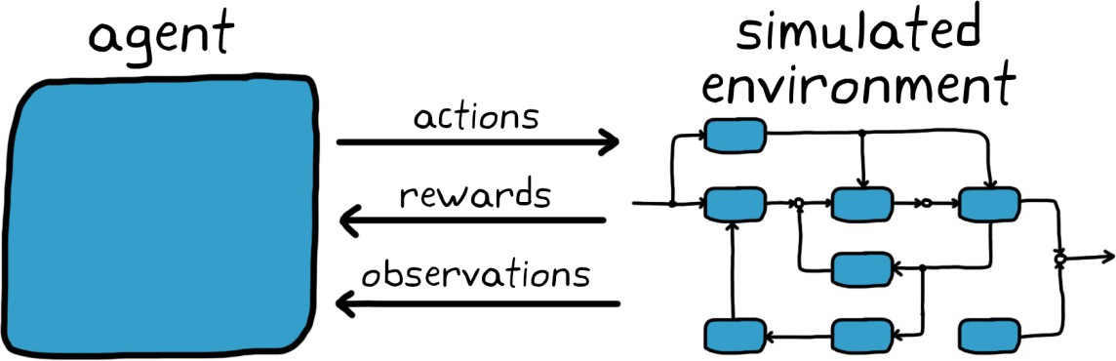
Real vs Simulated Environments
☺ Accuracy
☺ Training speed
☹ Risk
☺ Flexible simulated conditions
☺ Safety
☹ Model inaccuracies

Slide 24

Domain Randomization
You can randomize
initial conditions
model parameters
simulation scenarios
objectives (e.g. tracking signals)
sensor outputs
…

Slide 25
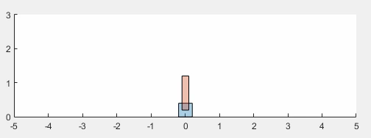
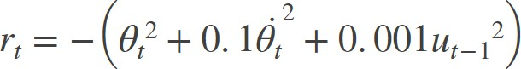
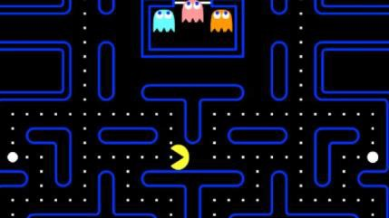
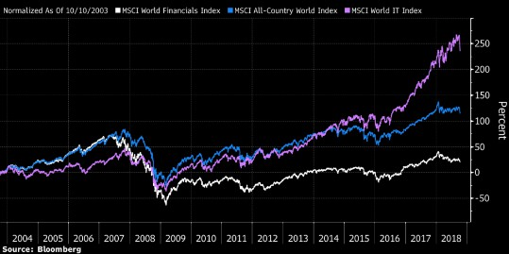
Reinforcement Learning Workflow
Environment
Reward
Agent
Training
Testing
Deployment
Maximize score
Maximize profit

Slide 26
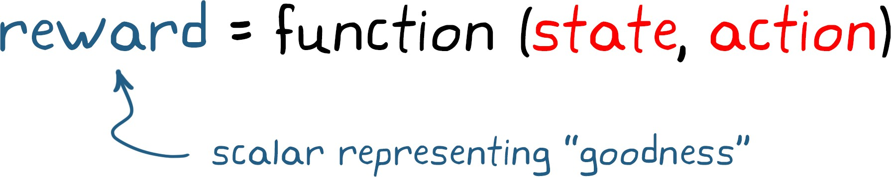
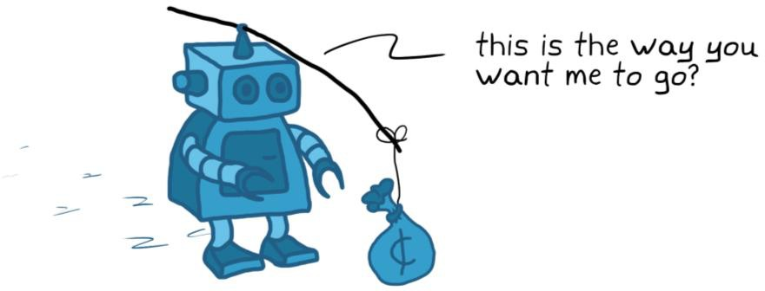
The Reward
Reward is a function that produces a scalar number that represents the “goodness” of an agent being in a particular state and taking a particular action.
There are no restrictions on creating a reward function. They could be
provided at each time step
provided at the end of an episode or after long periods of time (sparse rewards)
calculated based on some logic or a function
…

Slide 27
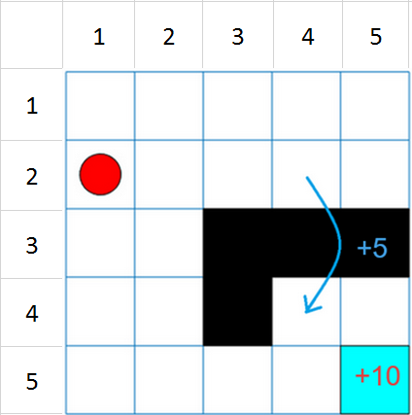
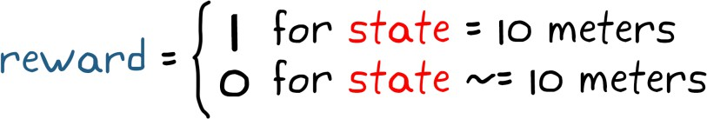

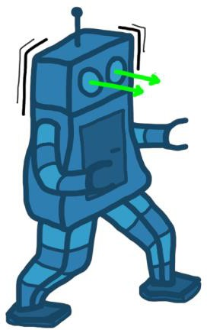
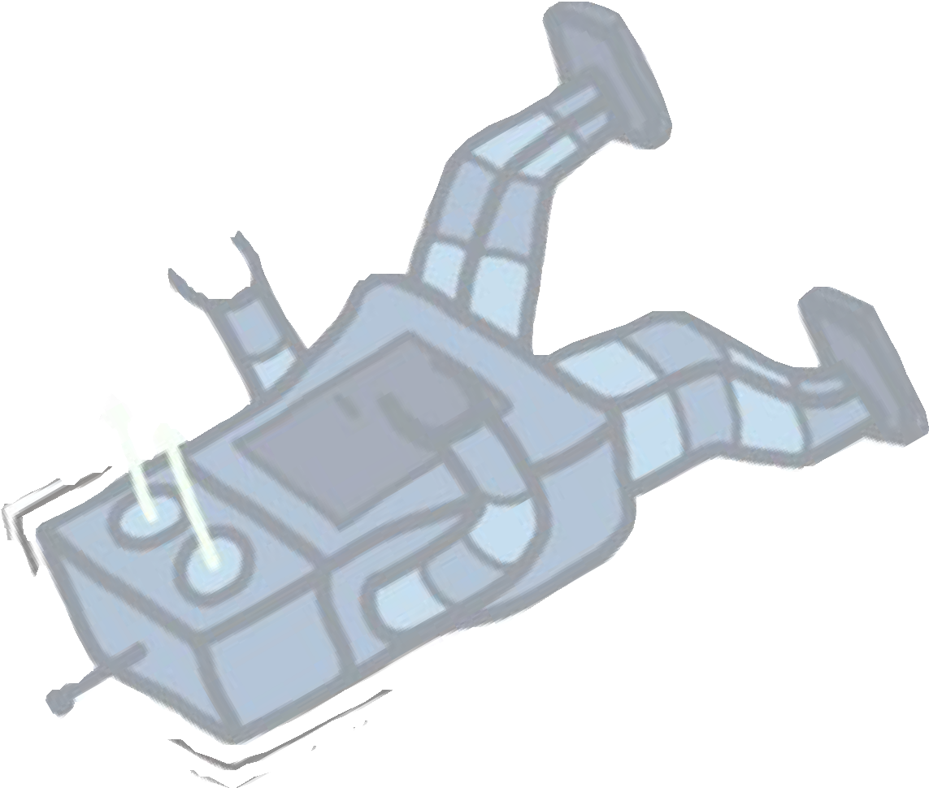

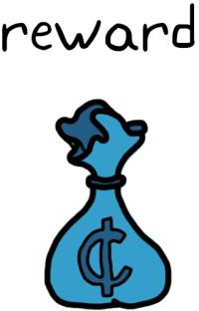
Sparse Rewards
With sparse rewards, the goal you want to incentivize comes after a long sequence of actions
10 meters
What is the problem with sparse rewards?
The chance that your agent will randomly stumble on the exact action sequence that produces
the sparse reward is very unlikely.

Slide 28

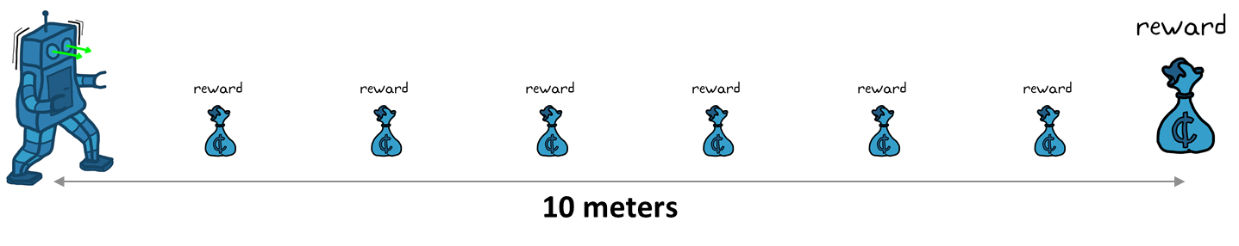
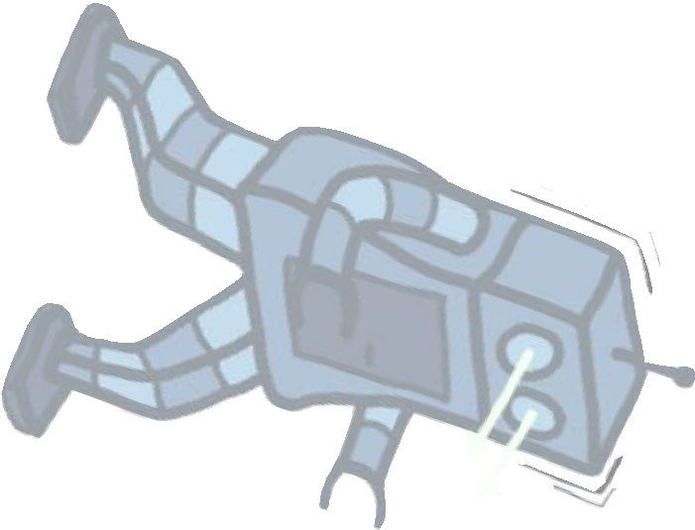
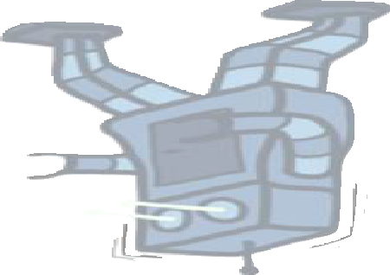

Reward Shaping
You can improve sparse rewards through reward shaping:
Providing smaller intermediate rewards that guide the agent along the right path.
10 meters
Reward shaping comes with its own set of problems
A poorly shaped reward function might cause your agent to converge on a solution that is not ideal, even if that solution produces the most rewards for the agent.

Slide 29
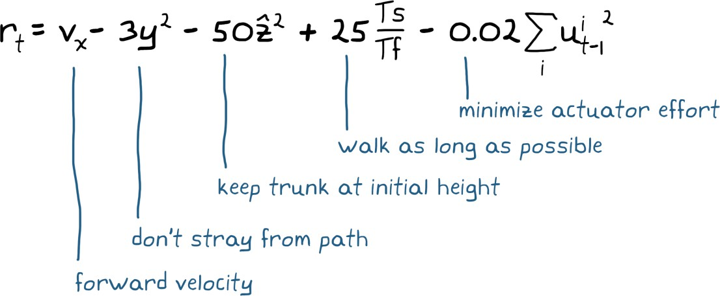
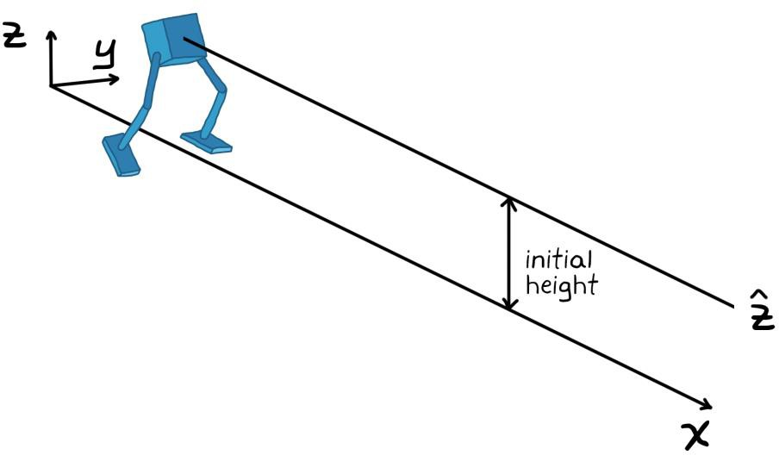
Reward Shaping
Unlike a domain-expert, the untrained agent is like a newborn baby
Reward shaping is the perfect opportunity to deliver domain-specific knowledge to the agent
Crafting a reward is one of the most difficult tasks in reinforcement learning.
It could take several iterations to get it right.

Slide 30
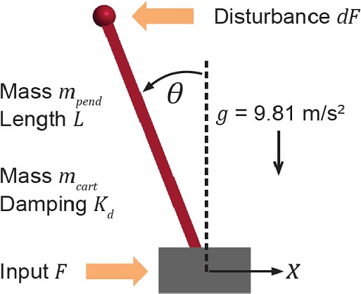
Exercise 1: Environment and Reward
Environment
Reward
Agent
Training
Testing
Deployment

Slide 31
Reinforcement Learning Workflow
Environment
Reward
Agent
Training
Testing
Deployment
Policy
Algorithm

Slide 32
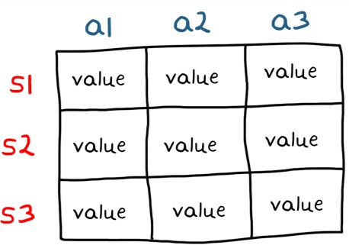
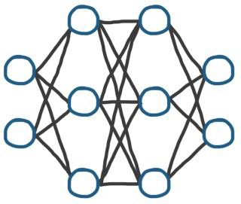
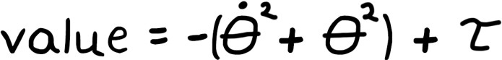
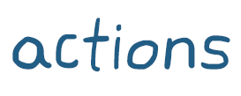
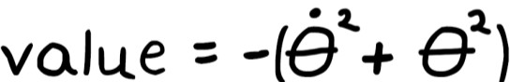
Representing a Policy
A policy is a function (mapping) that takes in observations and outputs actions.
It represents the decision-making strategy of the agent.
Tables
Neural Networks
Polynomials

Slide 33
Representing a Policy
Tables
Neural Networks
Polynomials
There are two approaches for structuring the policy function
Indirect way
Mapping/policy is inferred by consulting the value of a state or state/action pair
Direct way
There is a direct mapping/policy between observations and actions
Policy could be deterministic or stochastic

Slide 34
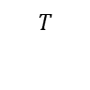
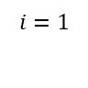
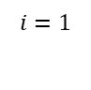
Value Functions
Reward: The instantaneous benefit of being in a state and taking a specific action.
Value: the total rewards an agent expects to receive from a state or state/action pair and
onwards into the future.
There are two ways for structuring value:
State-value function 𝑉^{π}(𝑠)
– It is only a function of state observations
$$T$$
_{𝑉}𝜋
𝑠 = 𝐸_{𝜋}[Σ𝑟_{𝑖} |𝑆₀ = 𝑠]
Value of selecting actions with
policy 𝝅 after starting from state s
Expected total reward
$$i=1$$
Action-value function 𝑄^{π}(𝑠, 𝑎)
– It is a function of both state observations and actions
Value of selecting action
$$T$$
_{𝑄}𝜋
= 𝐸_{𝜋}[Σ𝑟_{𝑖} |𝑆₀ = 𝑠, 𝐴₀ = 𝑎]
𝑠, 𝑎
Expected total reward
𝒂 at state 𝒔 and following
policy 𝝅 thereafter
$$i=1$$

Slide 35
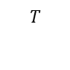
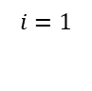
Value Functions with Discounting
There are two ways for structuring value:
State-value function 𝑉^{π}(𝑠)
– It is only a function of state observations
𝑠 = 𝐸_{𝜋}[Σ 𝛾^{𝑖−1}𝑟_{𝑖} |𝑆₀ = 𝑠]
_{𝑉}𝜋
$$T$$
Expected total discounted reward (previous slide)
How is a policy extracted from these value functions?
Value of selecting actions with
policy 𝝅 after starting from state s
$$i=1$$
Action-value function 𝑄^{π}(𝑠, 𝑎)
– It is a function of both state observations and actions
$$T$$
_{𝑄}𝜋
Value of selecting action 𝒂 at state
𝒔 and following policy 𝝅 thereafter
= 𝐸_{𝜋}[Σ 𝛾^{𝑖−1}𝑟_{𝑖} |𝑆₀ = 𝑠, 𝐴₀ = 𝑎]
𝑠, 𝑎
Expected total discounted reward (previous slide)
$$i=1$$

Slide 36
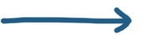
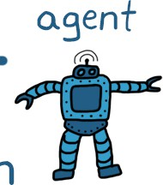

Example: Extracting the Policy from Value
Given optimal 𝑄∗, what is the optimal policy π∗ 𝑠 ?
Actions
s₀ s₁ s₂ s₃
+2 | +3 | +4 | +5
0 | +1 | +2 | +3
𝑄∗(𝑠, a)
a)
_{π}∗
𝑠 =
s₀
s₁
s₂
s₃
b)
_{π}∗
𝑠 =
s₀
s₁
s₂
s₃
c)
_{π}∗
𝑠 =
s₀
s₁
s₂
s₃

Slide 37
Example: Extracting the Policy from Value
Given optimal 𝑄∗, what is the optimal policy π∗ 𝑠 ?
Actions
s₀ s₁ s₂ s₃
+2 | +3 | +4 | +5
0 | +1 | +2 | +3
Tabular representations
𝑄∗(𝑠, a)
a)
_{π}∗
𝑠 =
s₀
s₁
s₂
s₃
b)
_{π}∗
𝑠 =
s₀
s₁
s₂
s₃
_{π}∗
For each state, select the action
c)
𝑠 =
with the largest Q value
s
0
s
1
s
2
s
3

Slide 38



Tables Do Not Scale Well
Problematic cases with tables:
Large state/action spaces
Slow to learn the value of each state
A lot of memory required for storage
Cannot generalize learning to unvisited states
Continuous state/action spaces

Slide 39


Solution: Parametric Function Approximation
Polynomials
Neural Networks
Parameters to be learned
π 𝑠 = 𝑤 𝑥(𝑠)
Neural networks are more powerful
– Can be used to represent complex policies

Slide 40
Representing a Policy
Tables
Policy structure:
Indirect
Mapping/policy is inferred by consulting
the value of a state or state/action pair
Typically relies on approximation of Q-
function
Direct
There is a direct mapping/policy between observations and actions
Policy could be deterministic or
stochastic
Typically requires parameterization of
policy (e.g. neural network weights)
Neural Networks
Polynomials

Slide 41
Actors and Critics
Direct policy representations, π(s), are called actors
(actions are direct output of representation)
Indirect policy representations through value, Q(s,a) and V(s), are called
critics (they criticize states/state-action pairs)
Whether you need direct vs indirect policy representation, i.e. whether you need an actor and/or a critic, is determined by the agent/algorithm.
Policy structure and choice of agent/algorithm are intertwined.

Slide 42

Types of RL Algorithms
Value-based
Indirect policy representation
Learning value function (critic)
Policy is extracted
Policy-based
Direct policy representation
Learning policy (actor)
No value function needed
Actor-Critic
Combines above two methods
Learning policy (actor)
Learning value function (critic)

Slide 43

Built-in Reinforcement Learning Agents as of
 | Type | Observation Space | Action Space
Deep Q-Networks (DQN) | Value-based | Continuous/Discrete | Discrete
Q Learning | Value-based | Continuous/Discrete | Discrete
SARSA | Value-based | Continuous/Discrete | Discrete
Policy Gradient (REINFORCE) | Policy-based | Continuous/Discrete | Continuous/Discrete
Deep Deterministic Policy Gradient (DDPG) | Actor critic | Continuous/Discrete | Continuous
Actor Critic (A2C & A3C as well) | Actor critic | Continuous/Discrete | Continuous/Discrete
Proximal Policy Optimization (PPO) | Actor critic | Continuous/Discrete | Continuous/Discrete
Twin Delayed Deep Deterministic Policy Gradient (TD3) | Actor critic | Continuous/Discrete | Continuous
Soft Actor Critic (SAC) | Actor critic | Continuous/Discrete | Continuous
Trust Region Policy Optimization (TRPO) | Actor critic | Continuous/Discrete | Continuous/Discrete
Model-Based Policy Optimization (MBPO) | Actor critic/ Value-based | Continuous | Continuous/Discrete

Slide 44
Exercise 2: Policy and Agent
Environment
Reward
Agent
Training
Testing
Deployment

Slide 45
Reinforcement Learning Workflow
Environment
Reward
Agent
Training
Testing
Deployment
Large number of simulations needed
Parallel & GPU computing can speed up training

Slide 46
Domain Randomization
You can randomize
initial conditions
model parameters
simulation scenarios
objectives (e.g. tracking signals)
sensor outputs
…

Slide 47

What Does It Mean to Learn?
Policy (direct or indirect) is a function made up of tunable parameters
There is a set of parameters that produces the optimal policy
Learning is the process of systematically adjusting parameters of the policy
(e.g. neural network weights)

Slide 48

Reinforcement Learning Workflow
Trained policy is a standalone
function
Environment
Reward
Agent
Training
Testing
Deployment
After training, only trained policy is needed

Slide 49



Deploying the Policy
Additional training may be required after deployment due to:
Model inaccuracies
Sensor noise
Environment changes not accounted for in training
…
Domain randomization may limit the amount of training needed after deployment.

Slide 50
Exercise 3: Training, Testing, and Deployment
Environment
Reward
Agent
Training
Testing
Deployment

Slide 51
Exercise 4: Teach a robot to walk!
Environment
Reward
Agent
Training
Testing
Deployment

Slide 52
End-to-end reinforcement learning
Measurements
Reinforcement Learning Agent
Motor torques

Slide 53
Agenda
Introduction to Reinforcement Learning
Deep Dive: Reinforcement Learning Workflow with Hands-On Examples
Defining environments and rewards
Creating policies and agents
Training, testing, and deploying agents
Complex problems: Teach a robot to walk!
Wrap-Up and Additional Resources

Slide 54
Key takeaways
What is reinforcement learning and why is it useful?
When should I use reinforcement learning?
How do I set up and solve a reinforcement learning problem?

Slide 55



Additional Resources
Reinforcement Learning Onramp
Instructor-led training
Demo videos
Documentation and examples written for engineers and domain experts
Tech Talk video series on Reinforcement Learning concepts for engineers
Practical Reinforcement Learning for Controls

Slide 56
Thank you! Q & A

Slide 57


